Slide 1
Delivery Status Prediction Model Supply chain (Domain)
PGPDSE FT Capstone Project – Final Report Chennai-May-2024-Group 6

Slide 2
PGPDSE FT Capstone Project – Final Report Chennai-May-2024-Group 6
BUSINESS PROBLEM STATEMENT
The challenge lies in predicting delivery delays in supply chain management to minimize disruptions and costs. Our objective is to develop a classification model that can predict order delivery status (successful/delayed). Using historical delivery data, we'll perform data preprocessing and exploratory analysis to understand key factors affecting deliveries. We'll implement machine learning models to predict delivery outcomes. The final model will be evaluated using standard metrics (accuracy, precision, recall, F1-score) to ensure reliability. This predictive system will enable proactive management of potential delays, enhancing overall supply chain efficiency.

Slide 3
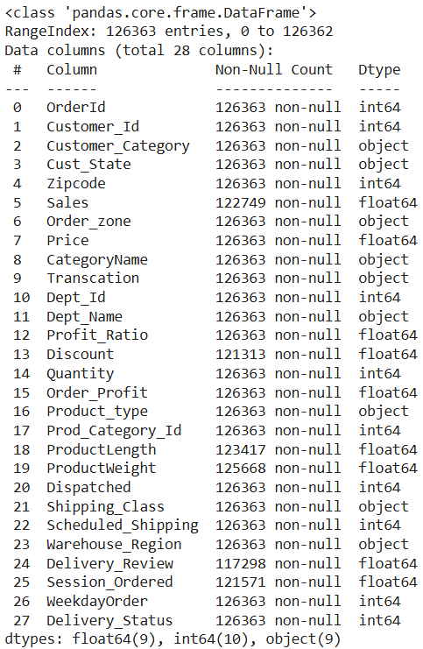
PGPDSE FT Capstone Project – Final Report Chennai-May-2024-Group 6
EXPLORATORY DATA ANALYSIS (EDA)
Data Features Overview
Numerical (7)
Sales, Price, Profit_Ratio
Discount, Order_Profit
ProductLength, ProductWeight
Categorical (16)
Customer: Category, State
Order: Zone, Transaction, Status (Target variable)
Product: Type, Category, Dept_Name
Shipping: Class, Scheduled, Dispatched
Logistics: Warehouse_Region
Time: Session, WeekdayOrder
Other: Quantity, Delivery_Review

Slide 4
PGPDSE FT Capstone Project – Final Report Chennai-May-2024-Group 6
Duplicate rows
There are no duplicates in our dataset.
Redundant columns or unwanted columns
Reasons for feature removal:
Order ID, Customer ID, and Product Category ID: These are unique identifiers for each order or item, so they do not add any predictive value to the model.
Zip code: Due to masking, it lacks enough detail for effective analysis and modeling.
Dept ID: It duplicates information already provided by Dept Name, making it redundant to retain both fields.
Null Value Imputation
Numerical features were imputed with the mean (normal distribution) or median (skewed distribution) to handle outliers, while categorical features were imputed with the mode to preserve category distribution. This approach ensures data integrity and enhances model stability.

Slide 5
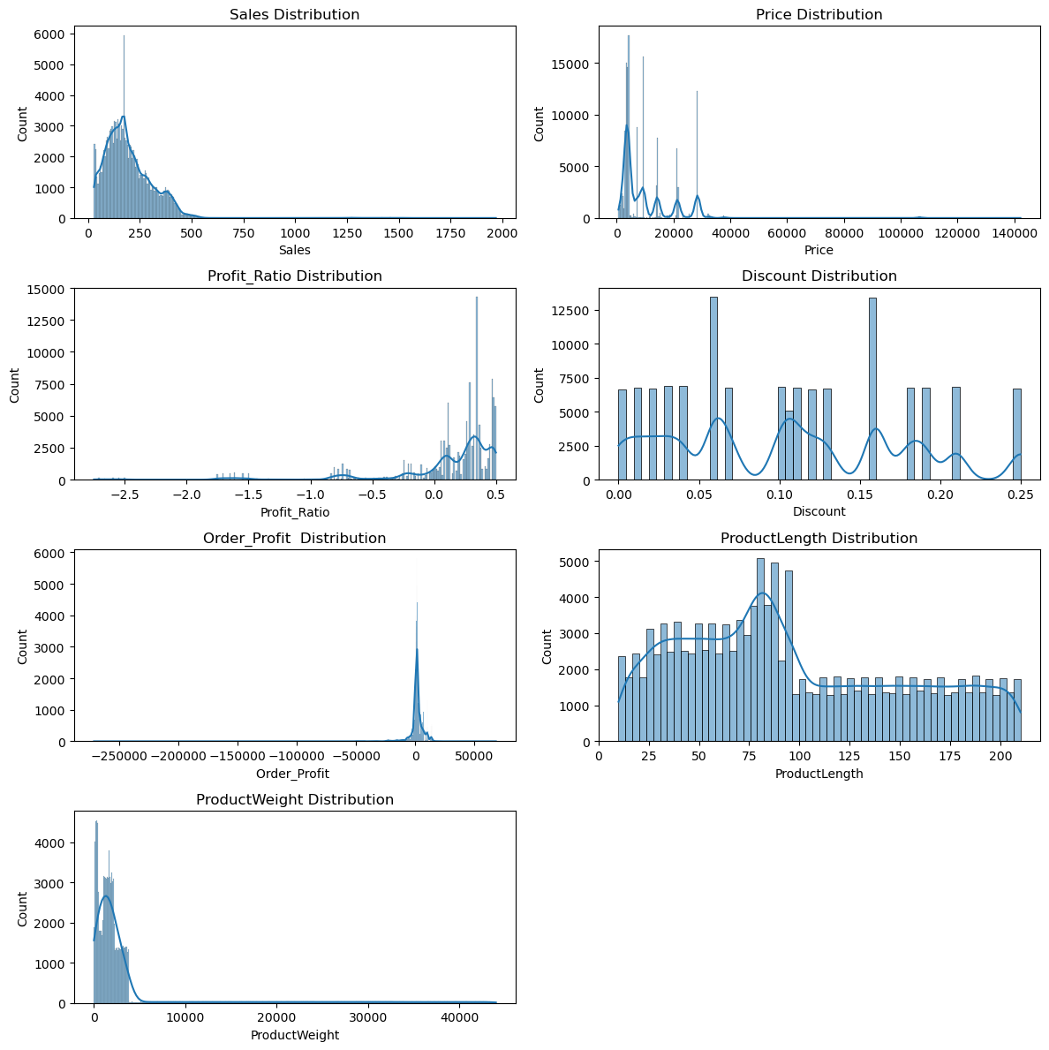
PGPDSE FT Capstone Project – Final Report Chennai-May-2024-Group 6
Distribution of variables

Slide 6
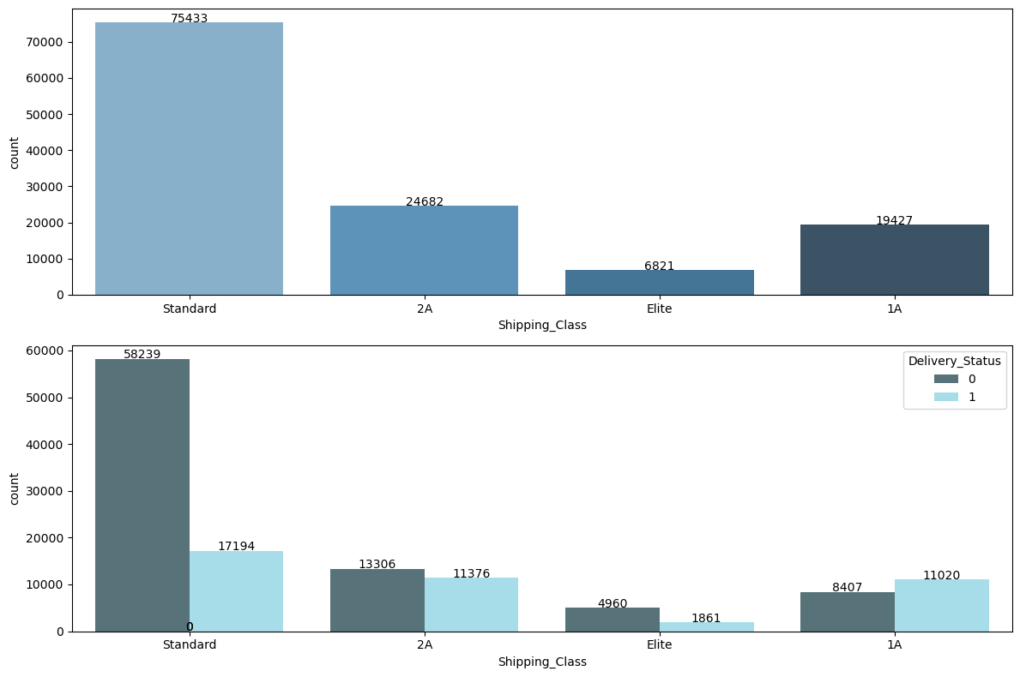
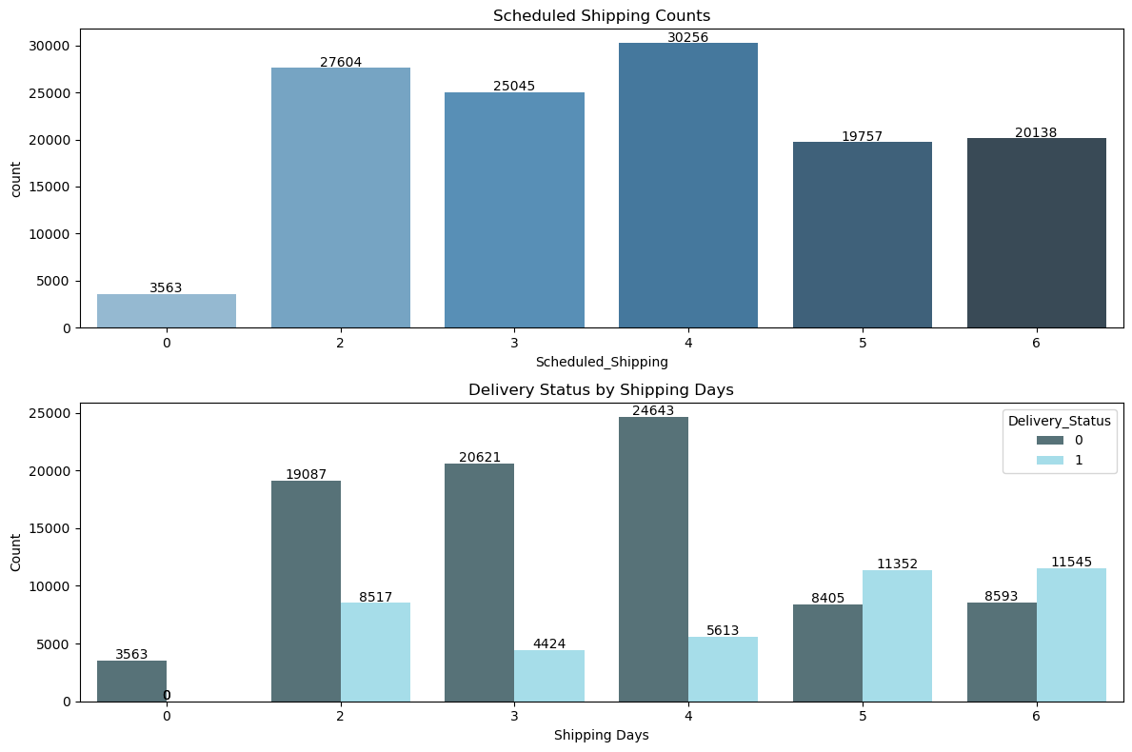
PGPDSE FT Capstone Project – Final Report Chennai-May-2024-Group 6
Relationship between variables

Slide 7
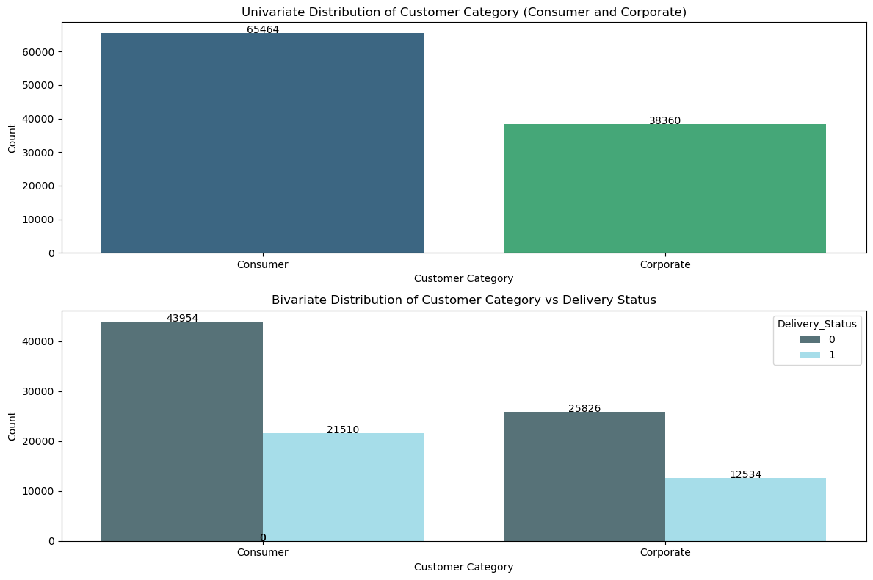
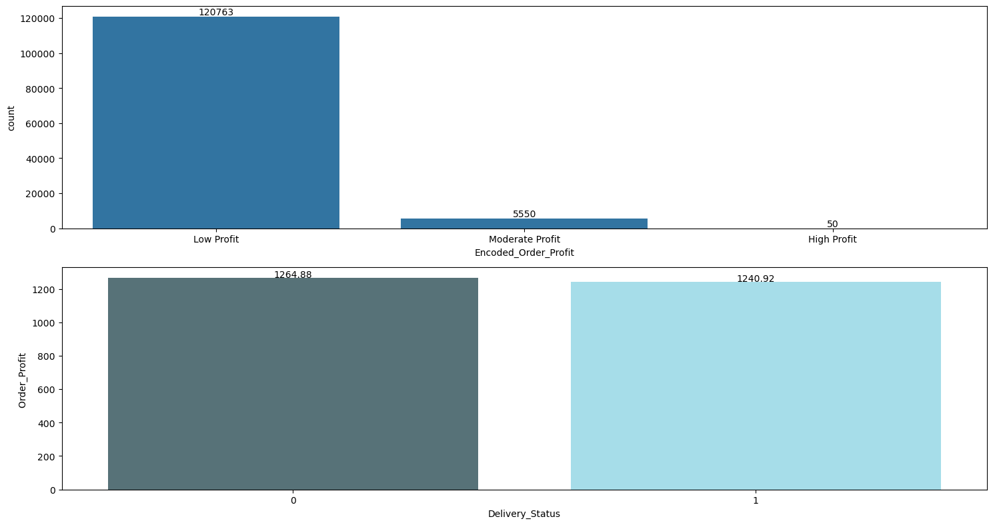
PGPDSE FT Capstone Project – Final Report Chennai-May-2024-Group 6

Slide 8
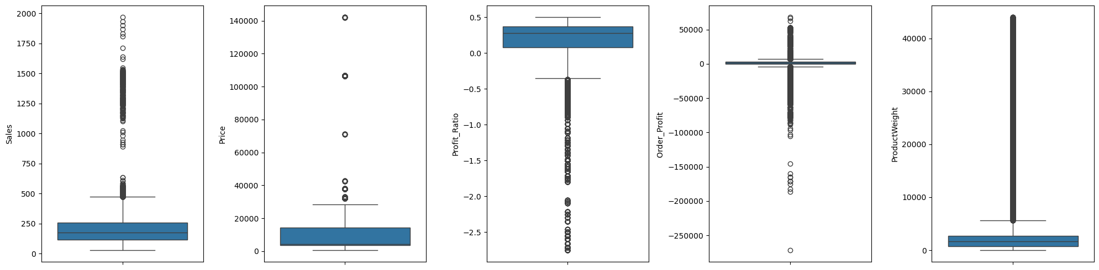
PGPDSE FT Capstone Project – Final Report Chennai-May-2024-Group 6
Outliers and treatment

Slide 9
PGPDSE FT Capstone Project – Final Report Chennai-May-2024-Group 6
Statistical significance of variables
T-Test
No significant difference in mean values between groups for Sales, Price, Profit_Ratio, Discount, Order_Profit, and ProductWeight.
Significant difference observed for ProductLength.
Chi-Square Test
No significant association with the target variable for Customer_Category, Cust_State, Order_zone, CategoryName, Dept_Name, Quantity, Dispatched, Warehouse_Region, Delivery_Review, Session_Ordered, and WeekdayOrder.
Significant association observed for Transaction, Product_type, Shipping_Class, Scheduled_Shipping, and Delivery_Status.
Shapiro Test
P-value = 0.0000 for Sales, Price, Profit_Ratio, Discount, Order_Profit, ProductLength, and ProductWeight, indicating all samples are not from a normal distribution.

Slide 10
PGPDSE FT Capstone Project – Final Report Chennai-May-2024-Group 6
Multicollinearity
All features were retained as the highest VIF (6.52 for Price) is below the threshold of 10, ensuring a balance between addressing multicollinearity and preserving the dataset's predictive value. This approach maintains dataset comprehensiveness and supports stable, interpretable model performance.
Transformation
Yeo-Johnson transformation was applied to highly skewed variables (Sales, Price, Profit Ratio, Order Profit, Product Weight) to stabilize variance and improve normality.
Scaling
Robust Scaler was used to handle outliers by scaling features based on the median and interquartile range.
Encoding
Applied One-Hot, CatBoost, Ordinal, and Binary Encoding to transform categorical features efficiently for modeling.

Slide 11
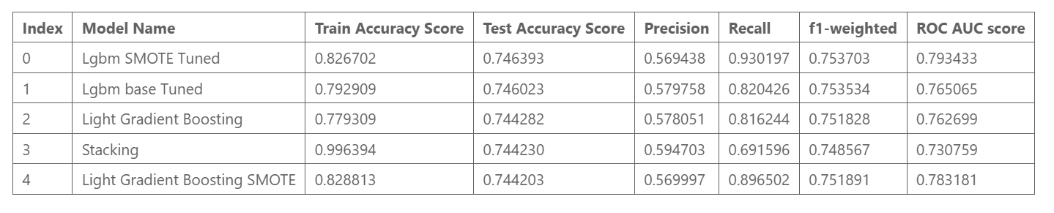
PGPDSE FT Capstone Project – Final Report Chennai-May-2024-Group 6
Model Building Various models (Logistic Regression, LightGBM, XGBoost, etc.) were evaluated. SMOTE addressed class imbalance, slightly improving recall but not overall metrics due to dataset noise. Feature selection had minimal impact, highlighting the need for richer features and external data.
Hyperparameter Tuning and Stacking GridSearchCV enhanced LightGBM and CatBoost performance, improving recall and F1 scores. Stacking combined multiple models for better metrics, though risks of overfitting remain.
Performance of Top Models LGBM with SMOTE and tuning achieved the highest recall (0.93). The stacking model showed potential for improved accuracy by leveraging diverse model strengths, though baseline models also performed reliably.

Slide 12
PGPDSE FT Capstone Project – Final Report Chennai-May-2024-Group 6
Closing Reflections Accurate predictions enhance proactive interventions and operational efficiency. However, data quality emerged as a significant drawback, impacting model reliability and insights. The absence of external factors like traffic or weather further limits performance.
Future efforts should prioritize improving data quality, integrating dynamic real-time data, and employing advanced feature engineering to address gaps and sustain improvements in model interpretability and performance.

Slide 13
PGPDSE FT Capstone Project – Final Report Chennai-May-2024-Group 6
Thank you !

